Slide 1
Version Control system
Git Training Course

Slide 2
Course Objectives
Set up git in your system
Basics of using Git
Create and fork repositories on GitHub and push changes back after working on them locally
Create branches and resolve merge conflicts
Tags, Branching, Merging and Reverting
Push, Pull and Tracking Remote repositories
Work on a project in collaboration with teams to perform code reviews, pull requests and releases using Bitbucket
Access Control: users and groups administration
Create and manages complex projects in GitLab
Git Logs and Auditing

Slide 3
Introduction Why Git is a better choice?
Git is widely used as a powerful and modern Version Control System
Active Tracking
Flexibility to move between file versions
Flexibility to collaborate with other team members
Ability to use online hosts such as GitHub
Secure

Slide 4
Introduction: Usage of Git
Many ways to use Git:
Terminal
Desktop app using GUI like SourceTree
GitHub
Bitbucket
GitLab

Slide 5
Course Outline
Git Basics
Getting started with Git
Push, Pull and Tracking Remote repositories
Branching, Merging, and Reverting in Git
Bitbucket and GitLab
Project
Course-end Part

Slide 6
Project highlights
Installing Git on Linux
Configuring Git
Create a Git Alias
Create a Local repository and configure it to GitHub
Create and clone a GitHub repository
Demonstrate the Git workflow
Track file changes as multiple commits
Reverting to Earlier Commits
Clean your working directory with git clean

Slide 7
Project highlights ( Contd..)
Deleting Files in Git
Renaming Files in Git
Creating a Repository in GitHub using https and SSH
Pulling Commits from GitHub
Collaborating Between Local and Remote Repository
Managing Multiple Commits in Git
Merging File Changes in Git
Issue Tracking in GitHub
Creating and verifying tags

Slide 8
Project highlights ( Contd..)
Switch between branches
Merging Branches in Git
Resolving Merge Conflicts in Git
Git tags
Git Auditing
Stashing in Git

Slide 9
Project highlights ( Contd..)
Course-End Project will be designed to meet all course points and practice all of these point.
Source code
Version control
Branching
Managing Commits
Managing pull/push requests
More …

Slide 10
Git Basics Overview of version control systems
What is version control?
What are version control systems?
Why to use version control systems – what are the benefits?
-> long-term change history
-> Branching – co-working
-> Trackable
-> Secure
-> Flexibility

Slide 11
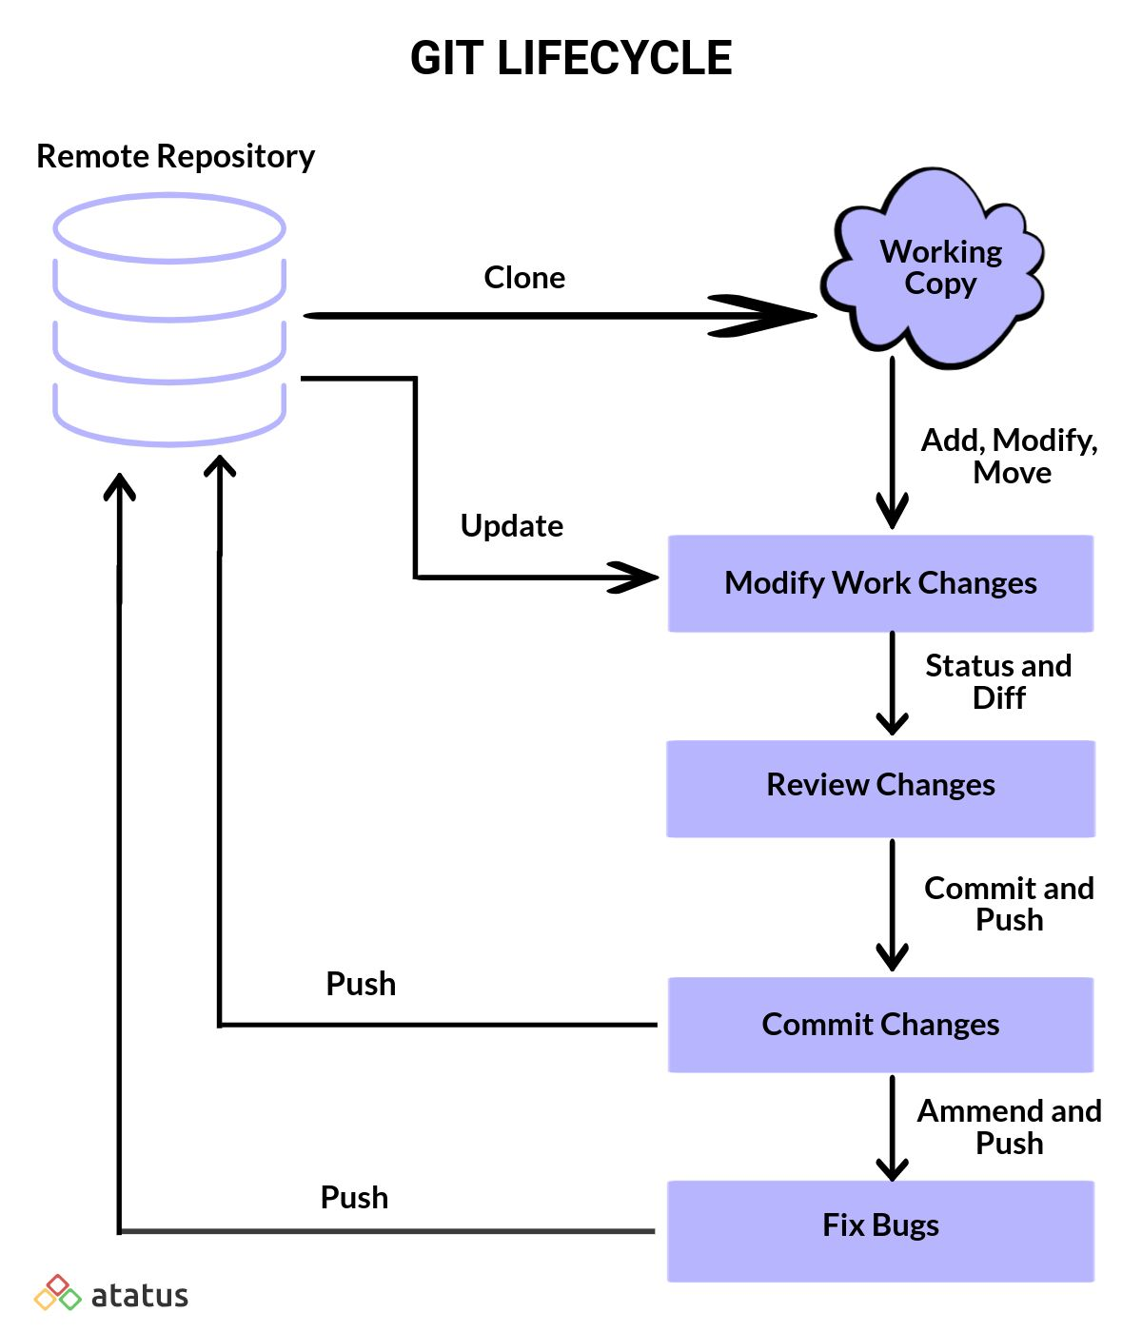
Git Basics: Git Life Cycle

Slide 12
Getting started with Git
Create Local Repository
Push Repo to GitHub
Demonstrate Git workflow
Track file changes in a Git Repo
Staging Changes as multiple Commits
Undo Changes – revert commits
Rename Files
Ignore files using .gitignore

Slide 13
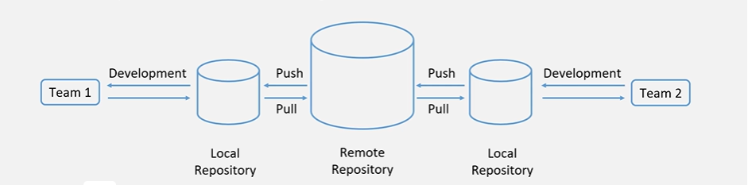
Remote Repositories
90% of version control system related work happens in the local repository
Remote repositories are needed for sharing data

Slide 14
Remote Repositories (Contd..)
Create a repo in GitHub using Https
Create a repo in GitHub using SSH
Create a fork and pull request
Pulling commits from GitHub
Collaborating Between local and Remote Repository
Managing Multiple Commits in Git
Merging File changes in Git
Creating and tracking issues
Push, Pull and Tracking Remote Repositories
Create and delete tags

Slide 15
Branching, Merging, and Reverting in Git
Branching in Git
Creating Branches and Switching between branches
Merging Branches
Resolving Merge Conflicts
Difference between branching and tagging
Stashing
Reverting in Git
Git Logs and auditing

Slide 16
Bitbucket
Creating a repository on Bitbucket
Copying Git repo and add files on Bitbucket
Pull changes from git repo on Bitbucket
Using branching on Bitbucket
Create a repo and add a teammate with Bitbucket
Clone and make change on a new branch with Bitbucket
Create a pull request to merge change with Bitbucket
Undoing changes with Bitbucket
Access control in Bitbucket

Slide 17
GitLab
SSH Key Setup
Creating and managing a project
Fork a project
Create a branch
Add a file
GitLab Users and Group permissions
GitLab issue tracker
Push changes and merge with GitLab

Slide 18
Thank You

